Slide 1
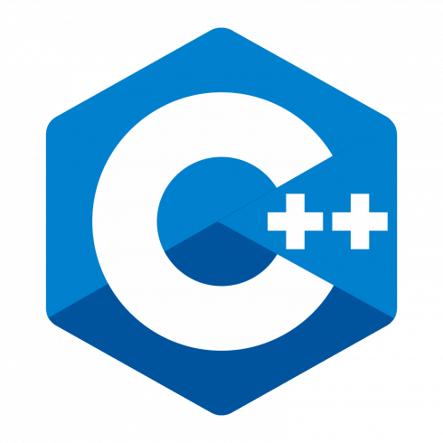
C++ Programming
Trainer : Pradnyaa S. Dindorkar
Email: pradnya@sunbeaminfo.com

Slide 2
We did ……
Shallow Copy and deep copy
static
Friend function
Operator Overloading
Object Oriented programming structure(oops)
Major pillars of oops
Minor pillars of oops
Association
Inheritance

Slide 3
Todays topic
Inheritance
Protected Data member
Types of Inheritance
Mode of inheritance
Diamond Problem
Virtual function
Function overriding
Early Binding and late Binding
Pure virtual function and Abstract class
Exception Handling
Template
Difference between Procedure Oriented and Object Oriented
MCQ

Slide 4
Mode of inheritance
If we use private, protected and public keyword to manage visibility of the members of class then it is
called as access specifier.
But if we use these keywords to extends the class then it is called as mode of inheritance.
C++ supports private, protected and public mode of inheritance. If we do not specify any mode, then
default mode of inheritance is private.

Slide 5
Mode of inheritance
Mode of inheritance (read "--->" as becomes)
Base Derived
public mode:
Public ---> Public
protected ---> Protected
private ---> NA
protected mode:
Public ---> Protected
protected ---> Protected
private ---> NA
private mode:
Public ---> private
protected ---> private
private ---> NA

Slide 6
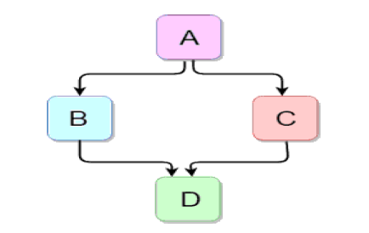
Diamond Problem
As shown in diagram it is hybrid inheritance. Its shape is like diamond hence it is also called as diamond inheritance.
Data members of indirect base class inherit into the indirect derived class multiple times. Hence it effects on size of object of indirect derived class.
Member functions of indirect base class inherit into indirect derived class multiple times. If we try to call member function of indirect base class on object of indirect derived class, then compiler generates ambiguity error.
If we create object of indirect derived class, then constructor and destructor of indirect base class gets called multiple times.
All above problems generated by hybrid inheritance is called diamond problem.

Slide 7
Solution to Diamond Problem– Virtual Base Class
If we want to overcome diamond problem, then we should declare base class virtual i.e. we should derive class B & C from class A virtually. It is called virtual inheritance. In this case, members of class A will be inherited into B & C but it will not be inherited from B & C into class D.
class A { }; class B : virtual public A { }; class C : virtual public A { }; class D : public B, public C { };

Slide 8
Virtual Keyword
Virtual function = It is the function which is called depending on type of object rather than type of pointer
If class contains at least one virtual function then such class is called polymorphic class.
• If signature of base class and derived class member function is same and if function in base class is virtual then derived class member function is by default considered as virtual.

Slide 9
Function overriding.
Process of redefining, virtual function of base class, inside derived class with same signature is called function overriding.
• Virtual function redefined inside derived class is called overrided function.
• For function overriding:
1. Functions must be exist inside base class and derived class.
2. Signature of base class and derived function must be same.
3. At least, function in base class must be virtual

Slide 10
Program Demo
Early Binding
create a class Base and Derived (void show() in both classes)
create base *bptr;
bptr=&d;
bptr->show()
Late Binding
create a class Base and Derived (void show() in both classes one as virtual in base class)
create base *bptr;
bptr=&d;
bptr->show()

Slide 11
Pure virtual function and Abstract class
Virtual fun which is equated to zero such function is called as Pure virtual function
Pure virtual function does not have body.
A class which contains at least one Pure virtual function such class is called as "Abstract class".
If class is Abstract we can not create object of that class but we can create pointer or reference of that class .
It is not compulsory to override virtual function but It is compulsory to override Pure virtual function
If we not override pure virtual function in derived class at that time derived class can be treated as abstract class.

Slide 12
Upcasting and downcasting
Upcasting and downcasting :-
Upcasting - process of converting derived class pointer into base class pointer
or Storing address of derived class object into base class pointer.
eg : Person *p=new student();
Downcasting - process of converting base class pointer into derived class pointer
or storing address of base class object into derived class pointer
eg : Student *s=new person();

Slide 13
Exception Handling
If we give wrong input to the application then it generates runtime error/exception.
To handle exception then we should use 3 keywords:
1. try
try is keyword in C++.
If we want to inspect exception then we should put statements inside try block/handler.
Try block may have multiple catch block but it must have at least one catch block.
2. catch
If we want to handle exception then we should use catch block/handler.
Single try block may have multiple catch block.
Catch block can handle exception thrown from try block only.
A catch block, which can handle any type of exception is called generic catch block / catch-all handler.
For each type of exception, we can write specific catch block or we can write single catch block which can handle all types of exception. A catch block which can handle all type of exception is called generic catch block.
3. throw
throw is keyword in C++.
If we want to generate exception explicitly then we should use throw keyword.
"throw statement" is a jump statement.
To generate new exception, we should use throw keyword. Throw statement is jump statement.
Note : For thrown exception, if we do not provide matching catch block then C++ runtime gives call to the std::terminate() function which implicitly gives call to the std::abort() function.

Slide 14
Consider the following code
In this code, int type exception is thrown
but matching catch block is not available.
Even generic catch block is also not
available. Hence program will terminate.
Because , if we throw exception from try block then catch block can handle it. But with the help of function we can throw exception from outside of the try block.
int main( void )
{
int num1;
accept_record(num1);
int num2;
accept_record(num2);
try
{
if( num2 == 0 )
throw 0;
int result = num1 / num2;
print_record(result);
}
catch(char ex )
{
cout<<ex<<endl;
}
return 0;
}

Slide 15
Template
If we want to write generic program in C++, then we should use template.
This feature is mainly designed for implementing generic data structure and algorithm.
If we want to write generic program, then we should pass data type as a argument. And to catch that type we should define template.
Using template we can not reduce code size or execution time but we can reduce developers effort.
int num1 = 10, num2 = 20; swap_object<int>( num1, num2 ); string str1="Pune", str2="Karad"; swap_object<string>( str1, str2 ); | In this code, <int> and <string> is considered as type argument.
template<typename T> //or template<class T> //T : Type Parameter void swap( b obj1, T obj2 ) { T temp = obj1; obj1 = obj2; obj2 = temp; } | template and typename is keyword in C++. By passing datatype as argument we can write generic code hence parameterized type is called template

Slide 16
Difference between Procedure Oriented and Object Oriented
Procedure Oriented
Emphasis on steps or algo
Programs are divided into small
code units called Functions.
Most function shares global data and can modify it
Data moves from function to function
Follows Top-down approach
Example= C
Object Oriented
Emphasis on data of program
Programs are divided into small data units called classes
Data is hidden and not accessible outside the class
Objects are communicating with each other
Follows Bottom-up approach
Example =C++,JAVA,C#.NET, python

Slide 17
We covered ….
1 : Introduction to C++
2 : Function features
3 : class and object
4 : cin - cout
5 : static, const, friend
6 : memory management
7: Operator overloading
8 : Object oriented concept
9 : Association
10 : Inheritance
11: virtual function
12: Advance C++ feature

Slide 18
Thank You

Slide 19
Thank You

